Slide 1
Group 20 Game Pitch
Max Carter
Ethan Ward
Joseph Sawyer

Slide 2
Interference (WiP)
Story – A builder in his late 20s suffered a fall during one of his jobs and is now coping with retrograde amnesia. He looks through his old journals and diaries in an attempt to recover some of his lost memories
Gameplay – Top-down collection game / shooter
Themes (Obscure Sorrows):
Monachopsis
Occhiolism

Slide 3
Mechanics
The game is top-down
The Interference tries to attack the player
The main character can shoot the Interference
The main character has a health bar
The player collects memory fragments to uncover
more of the image (memory) that is covered by the fog

Slide 4

Art Style

Slide 5
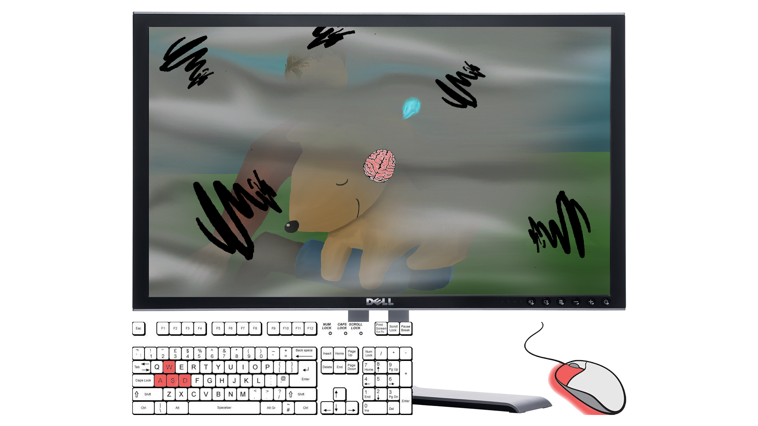
Mock-Up

Slide 6
Future Considerations
Boss battles
Power-ups
Multiple stages
Difficulty levels

Slide 7
Admin
Meetings
Total – 4
Attendance – all present and on time
Emails
Max – 25
Ethan – 8
Joseph - 8

Slide 8
Thank you for listening!
Any questions?

